Slide 1

Project III.
Nimród-Rajmond-Ádám

Slide 2
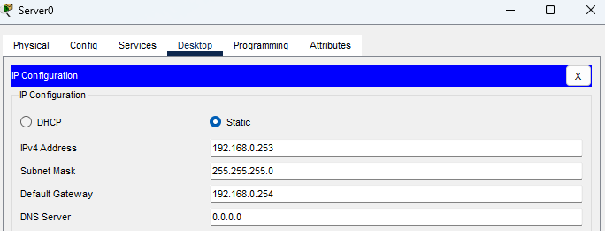
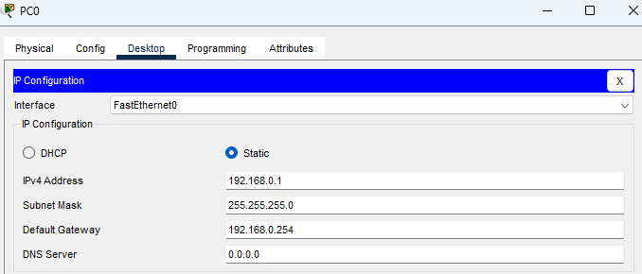
Ip config

Slide 3


R1 i. (timestamps, dhcp, ntp server)
Syslog:
Ntp server:
Timestamps:
DHCP config:

Slide 4

Switch i. (syslog, ntp server, mac -address filtering)
Ntp server:
Syslog:
Mac-address filtering :

Slide 5
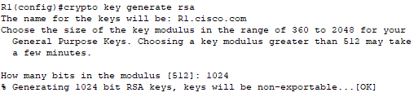
R1 ii. (new user, domain name, virtual lines> ssh, key, user login logging, login with ssh, login settings, AAA config)
New user:
Domain name:
SSH Virtual lines:
Generating key:

Slide 6
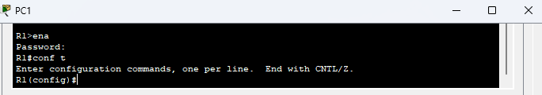
R1 iII.
User login logging:
Login with SSH:
Login settings:

Slide 7

R1 iii.
AAA config:
AAA tracking:
Turning off tracking:

Slide 8
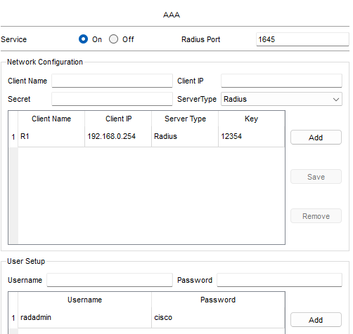


Radius server, login via user, authentication for remote users

